Slide 1


SCHOOL OF INFORMATICS DEPARTMENT OF COMPUTER SCIENCE
Disease Identification System Using Symptoms
Presenting by:
K. Ranga Sai
Course instructor:
Srinivasrao Kunchala

Slide 2

AGENDA
Abstract
Introduction
Literature review
Research methodology
Project requirements
Project design
Project implementation
Project result
Conclusion
Future scope

Slide 3

ABSTRACT
The Disease Identification System Using Symptoms is a machine learning-based web application designed to predict diseases based on user-provided symptoms. The system utilizes a Flask-based web interface to accept symptoms, processes them through a Support Vector Classifier (SVC) model, and returns the most probable disease along with precautionary measures, medications, recommended diet, and suggested workouts. The project aims to assist individuals in early identification of potential diseases, enabling timely consultation with healthcare professionals. By integrating multiple datasets, the system offers accurate predictions and detailed healthcare recommendations.

Slide 4

INTRODUCTION
Healthcare is increasingly relying on data-driven solutions to enhance early disease detection and diagnosis. Identifying diseases at an early stage can significantly improve treatment outcomes and reduce complications. However, individuals often overlook or misinterpret early symptoms, leading to delayed diagnosis. This project aims to address this issue by developing a symptom-based disease identification system. By leveraging machine learning algorithms, the system predicts diseases based on user-reported symptoms and provides personalized healthcare recommendations, including precautionary steps, medications, diets, and workouts.

Slide 5
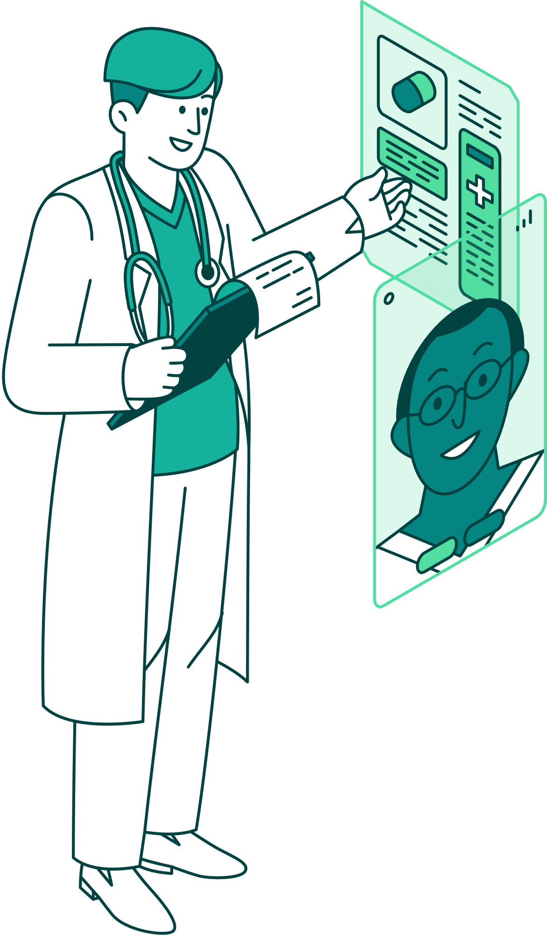
LITERATURE REVIEW
AI-based disease category prediction model using symptoms from electronic patient records in Afaan Oromo text
AI-based disease prediction – Uses machine learning for symptom-based classification in Afaan Oromo text.
https://www.researchgate.net/publication/378889627_Early-Stage_Disease_Prediction_from_Various_Symptoms_Using_Machine_Learning_Models
Early-stage disease prediction – Analyzes symptom frequency to improve prediction accuracy.
https://papers.ssrn.com/sol3/papers.cfm?abstract_id=3661426
Disease prediction using ML – Achieves 93.5% accuracy using Weighted KNN on patient symptoms.

Slide 6
LITERATURE REVIEW
https://www.ijpmh.latticescipub.com/wp-content/uploads/papers/v4i6/G92340811922.pdf?
Symptom-based disease prediction – Uses predictive modeling to forecast diseases from symptoms.
https://www.researchgate.net/publication/359461868_Symptoms-Based_Disease_Prediction_Using_Big_data_Analytics
Optimized ML classifiers for disease prediction – Compares different ML algorithms for symptom-based disease diagnosis.

Slide 7

RESEARCH METHODOLOGY
Existing Methodology:
Proposed Methodology:
Uses machine learning algorithms for accurate disease prediction.
Considers multiple symptoms to enhance diagnosis precision.
Provides personalized recommendations for medication, diet, and precautions.
Ensures user-friendly interface for easy symptom input and result interpretation.
Uses basic symptom checkers with limited accuracy.
Relies on predefined symptom-disease mapping, which may miss complex cases.
Provides generalized results without considering individual factors.
Lacks personalized recommendations (e.g., diet, exercise).

Slide 8


PROJECT REQUIREMENTS
Software
Requirements:
Hardware
Requirements:
Datasets:
Python 3.x
Flask (for web application)
Pandas and NumPy (for data manipulation)
Scikit-learn (for model training)
Jupyter Notebook (for model testing)
HTML/CSS for the web interface
Processor: Intel i5 or above
RAM: 8 GB or higher
Storage: 20 GB of free disk space
Symptoms and disease mapping dataset
Precautionary measures dataset
Medications dataset
Diet and workout dataset

Slide 9
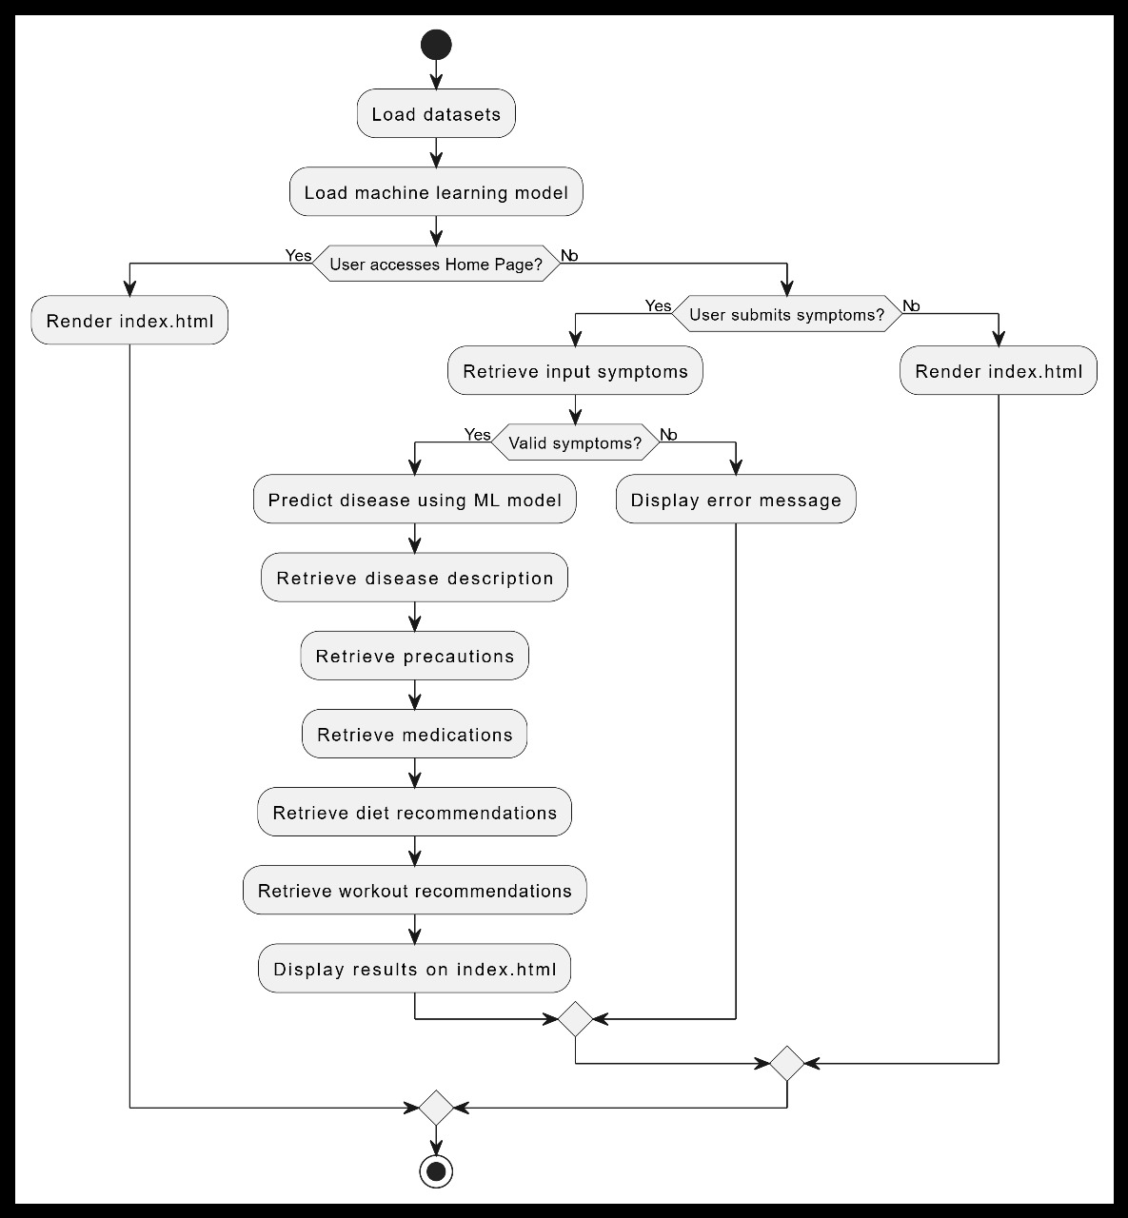
PROJECT DESIGN
FLOW CHART

Slide 10
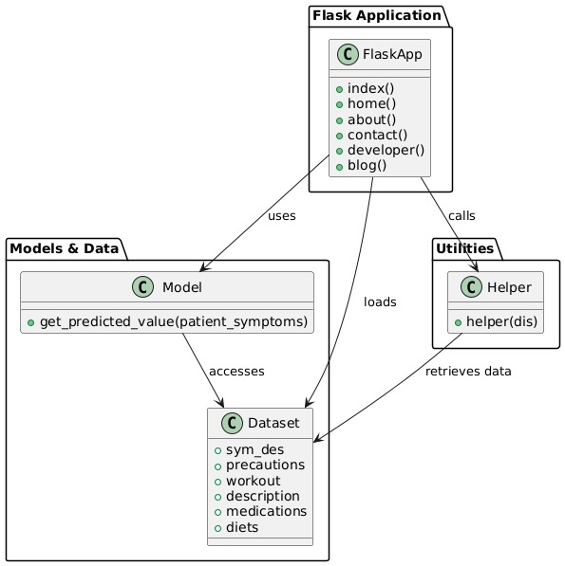
PROJECT DESIGN
UML DIAGRAM

Slide 11
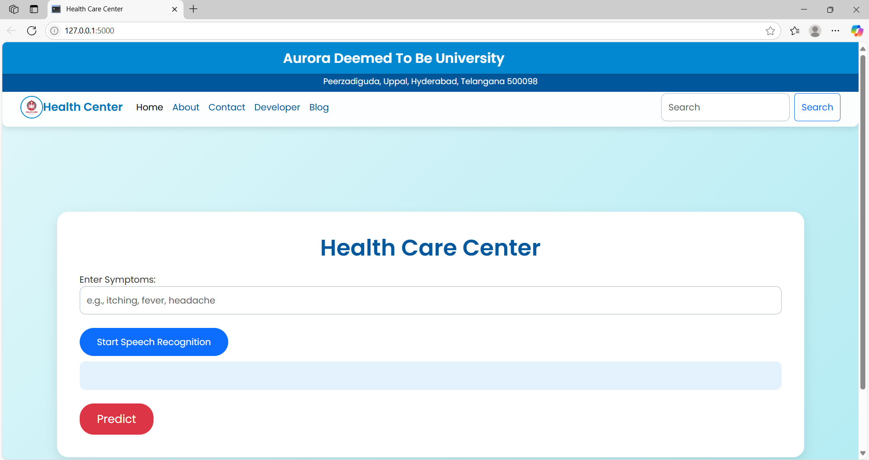
PROJECT RESULT
Healthcare Recommendations:
o The system offers precautionary measures for the predicted disease.
o It suggests medications, dietary changes, and workouts to promote recovery.

Slide 12
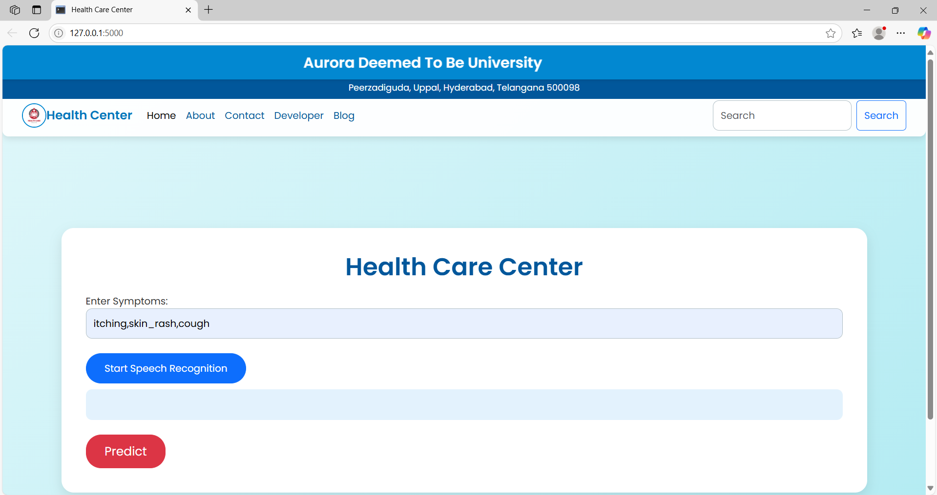
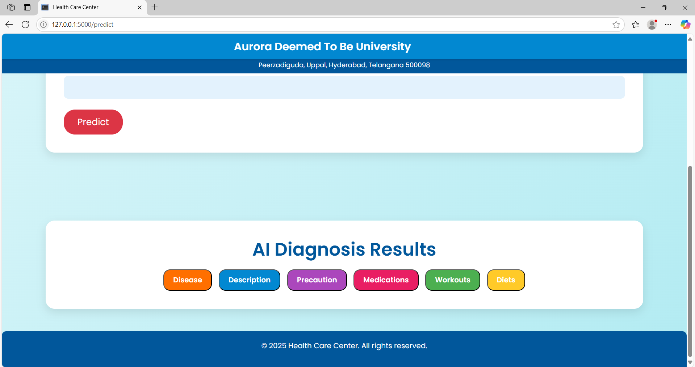
PROJECT RESULT
Accurate Disease Prediction:
o The SVC model successfully predicts diseases with 85-90% accuracy.
o Real-time symptom validation ensures reliable input processing.

Slide 13
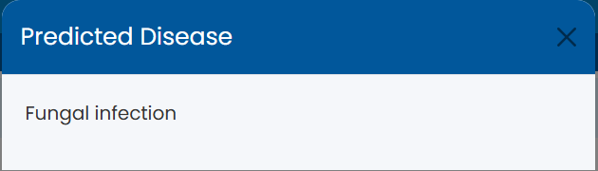
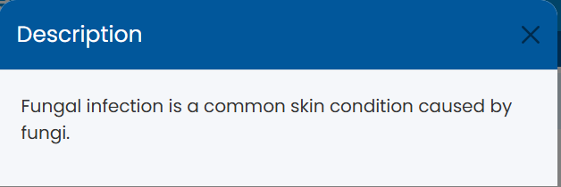
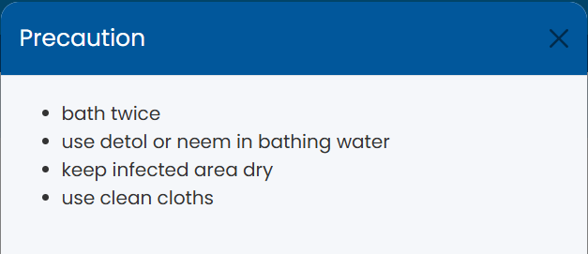
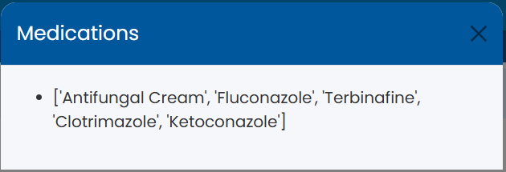
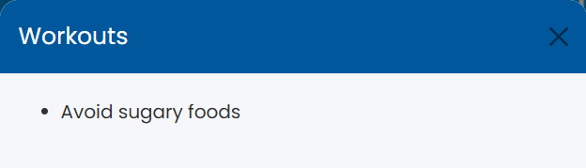
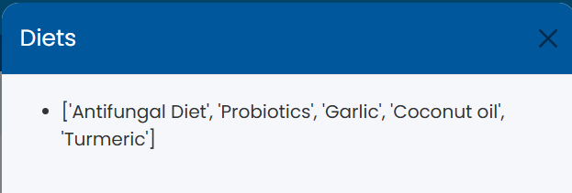
PROJECT RESULT
User-friendly Interface:
o The Flask-based interface provides an easy-to-use web-based platform.
o Users can interact with the system and receive instant predictions.

Slide 14

CONCLUSION
The Disease Identification System Using Symptoms is a practical application of machine learning in healthcare. It enables users to identify potential diseases based on their symptoms and receive relevant healthcare recommendations. The system promotes early diagnosis, empowering individuals to seek timely medical attention. With its accurate predictions and personalized suggestions, the project contributes to enhanced disease management and preventive care.

Slide 15
FUTURE SCOPE
Multi-language Support:
Make the system accessible to non-English speakers.
Mobile Application:
Extend the system to a mobile app for wider accessibility.
Real-time API Integration:
Connect with external healthcare databases for updated information.

Slide 16

THANK YOU!

